Slide 1
Software AG World of platforms 2016
03/03/2016

Slide 2
Table of contents
Who are we?
A company at the cutting-edge of e-commerce (retails) & e-services (commercial lines)
CRM for public & corporate sector
Digital integration layer to support of business objectives

Slide 3
Who are we?

Slide 4
2016
Ethias, responsible insurer

Slide 5
Ethias on the move
Ethias is a group with a mutual insurance philosophy
Willing to be a player in the social economy
Offering its clients the best service for the best price
Via direct sales

Slide 6
Ethias figures in short
1,818 employees
3rd Insurer on Belgium market (life + non-life)
1st direct insurer on Belgium market
1.13 billion in own funds
409 million in operational income
(31/12/2014)

Slide 7
Channels
Agencies
41 agencies
203 advisors
242,000 quotations in Non-Life
Internet
4,000,000 visitors/year
430,000 quotations in Non-Life
Contact Center
2 Contact Centers
70 employees
2,950 calls/day
147,000 quotations in Non-Life
Internal services
Inspectors
43 contact points for the public and corporate sector
Brokers
for companies

Slide 8
Le plan pluriannuel de RSE 6/6
A company at the
cutting-edge of
e-commerce (retails) &
e-services (commercial lines)
Contact : rse@ethias.be

Slide 9
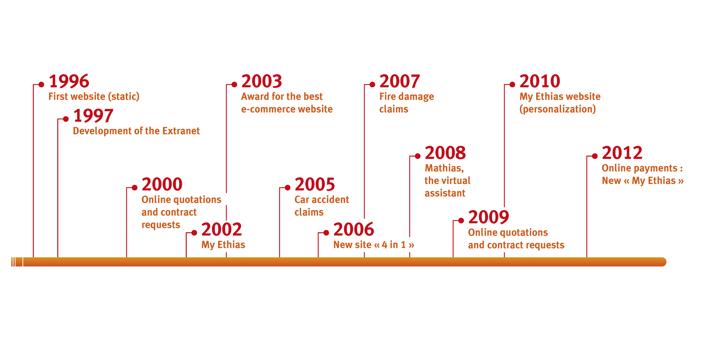
History
Ethias, pioneer on the web

Slide 10
And now…
Ethias, continue to innovate on the web
2015: Ethias launches a brand new site of e-commerce for retail with responsive design and subscription full-online including secure payment for 10 products.
2016 : Ethias will improve and modernize existing web site for commercial lines and will offer e-services for insured in Healthcare via new site and mobile app

Slide 11
E-commerce for retails on Ethias.be
Objectives sustaining the redesign of our website
Make ethias.be a real e-commerce web site
Optimize the user experience and the conversion funnel
Improve the conversion ratios
Consolidate the position of Ethias as #1direct insurer on the web

Slide 12
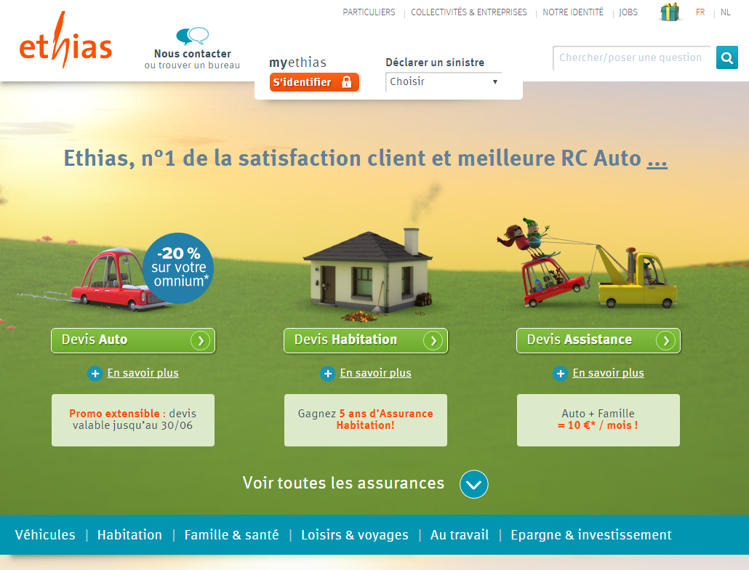
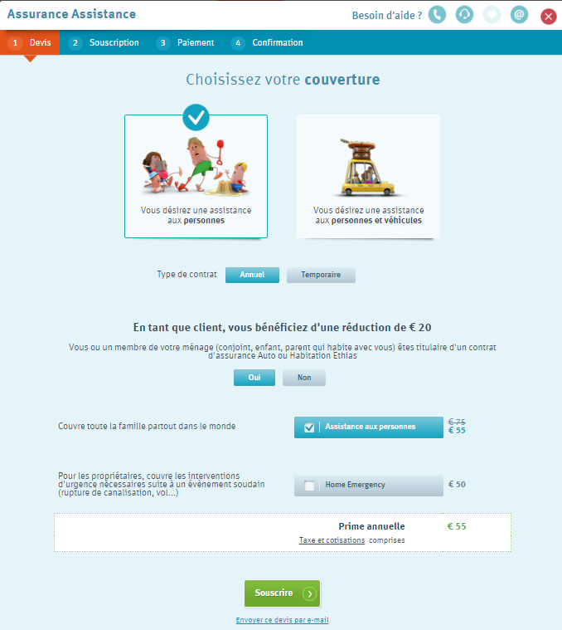
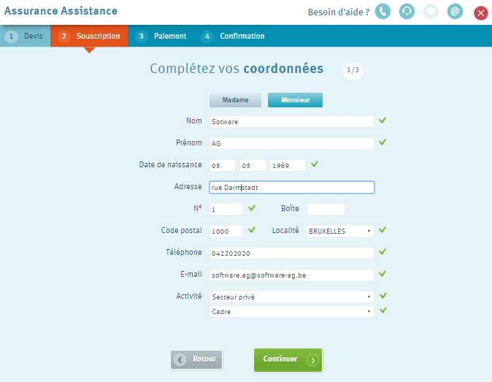
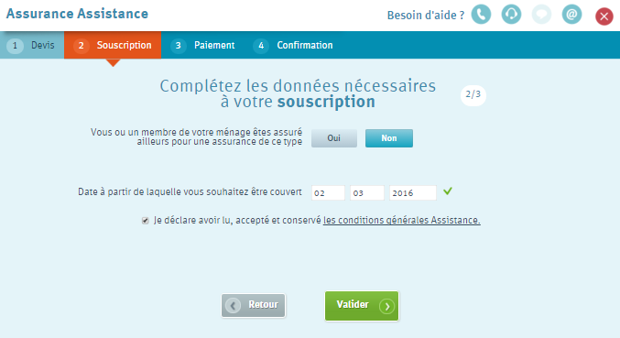
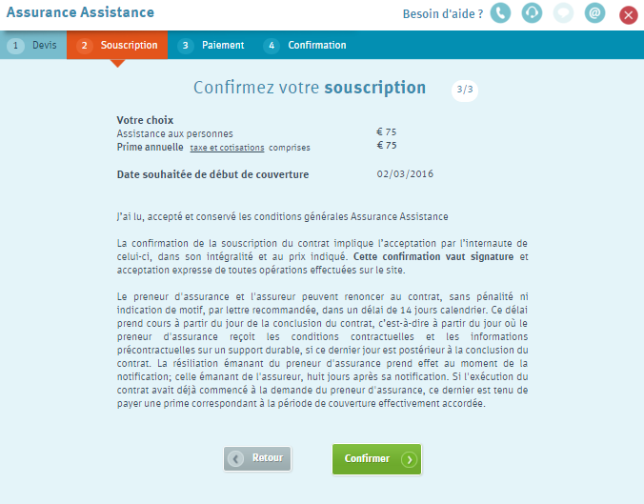
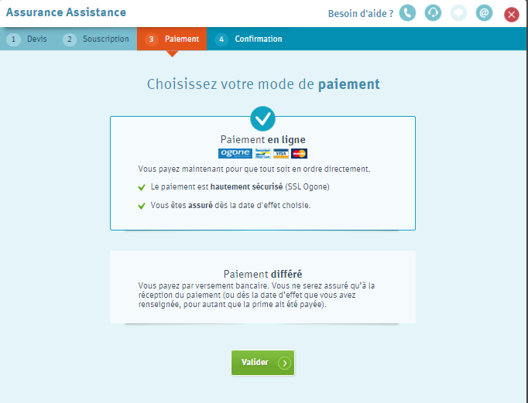
Ethias.be : User experience

Slide 13
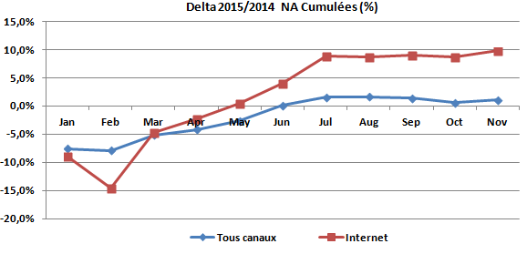
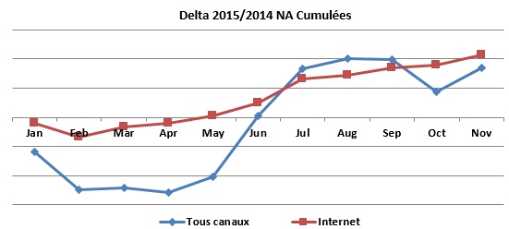
Ethias.be : results
Indicative usage figures
+/- 10.000 unique visitors/day
+/- 45.000 pageviews/day
+/- 2.000 quotes/day
+/- 150 on-line new contrats/day
Web drives the growth of Ethias sales
Mobile usage is higher than expected (also for subscriptions)
Visits: 70% PC – 20% Mobiles – 10% Tablets
Contracts: 80% PC – 10% Mobiles – 10% Tablets

Slide 14
The Extranet
The Extranet, current secure website for the public & corporate sector
Over 30,000 customers
900,000 page views per month
99% of claims declarations in workers compensation

Slide 15
The Extranet
The Extranet current e-services
Direct and secured connection
Online information about the insurance portfolio
First Notice of loss and follow-up claims process
Online claims analytics
Prevention
Interactions with customer systems

Slide 16
The Extranet
The evolutions in 2016
Site rebranding with optimized user experience
Responsive design
Improve e-services for policy management
Push notification by mail
Prepare the deployment of new transactional services based on our future back-end policy and claims center (Guidewire)

Slide 17
E-Services for insured people
Healthcare e-services for commercial lines
New website and mobile app
Consult coverage for family
Claims and payments follow-up
Upload expense reports

Slide 18
Le plan pluriannuel de RSE 6/6
The road to digital
Customer Relationship Management

Slide 19
CRM for public & corporate sector
Project Goals
Increase effectiveness of retention management
Improve the opportunities management
Adapt IT tools to mobility of commercial workforces
Optimize and digitalize communications between Back and Front office
Allow a proximity management of prospects and customers
Share globally contact’s information
Standardize and optimize the processes to manage commercials / claims missions
Automatize and digitalize processes
Regulatory compliance (Mifid)

Slide 20
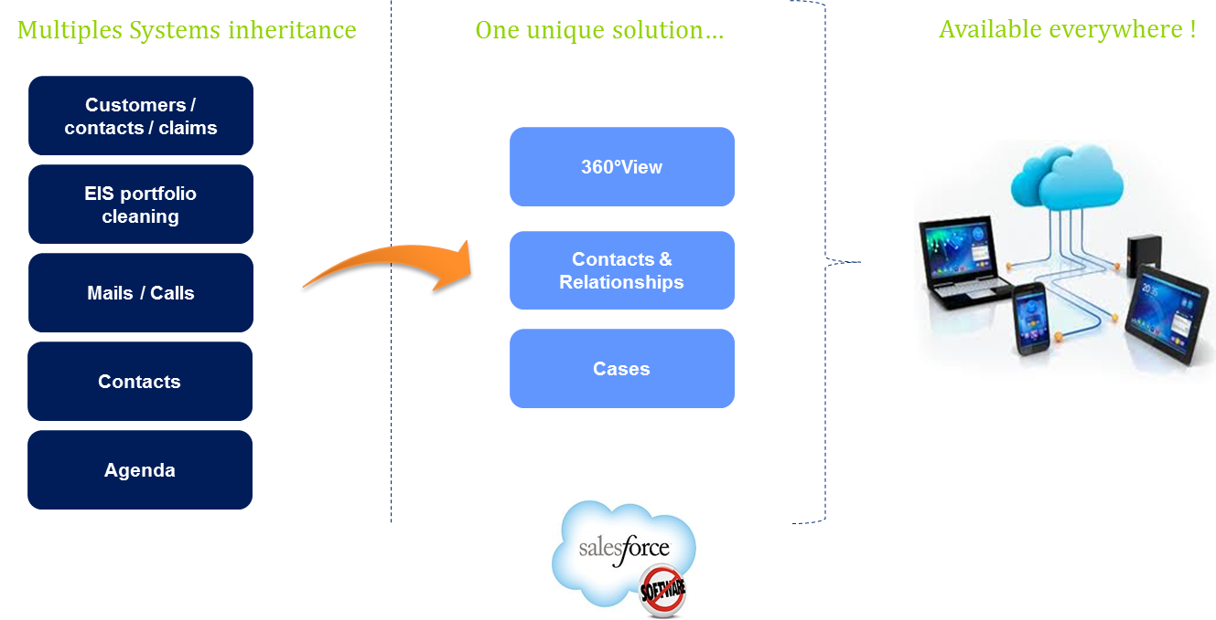
CRM @ Ethias - achievements

Slide 21
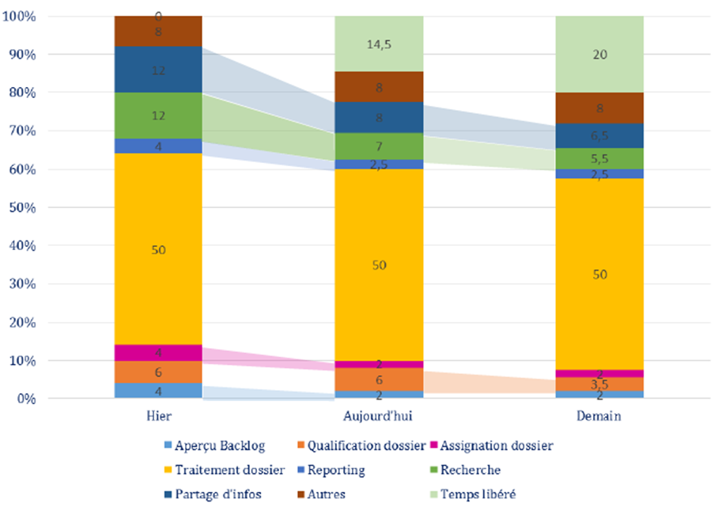
Evolution of back office workload

Slide 22
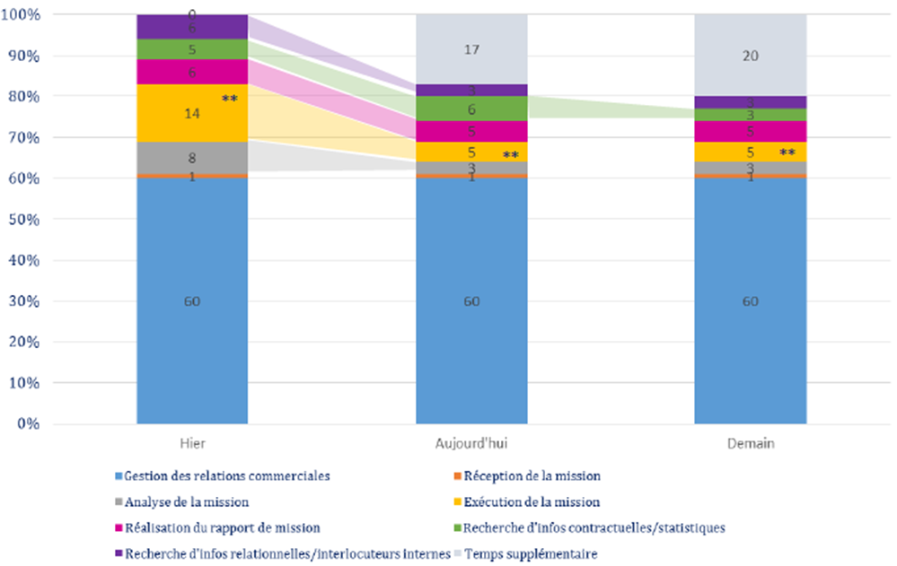
Evolution of commercial workload

Slide 23
Le plan pluriannuel de RSE 6/6
Digital integration layer to support of business objectives

Slide 24
Integration layer challenges
Integrate & digitalize multiple heterogeneous platforms
Customer, Policy, Claim management on legacy mainframe
CRM Salesforce in the cloud
Marketing management on premise
Contact center Genesys tooling
Sites Content Management using Adobe AEM
Operation Data Store on Oracle
Document production based on custom mainframe application
Document archiving in Documentum
…

Slide 25
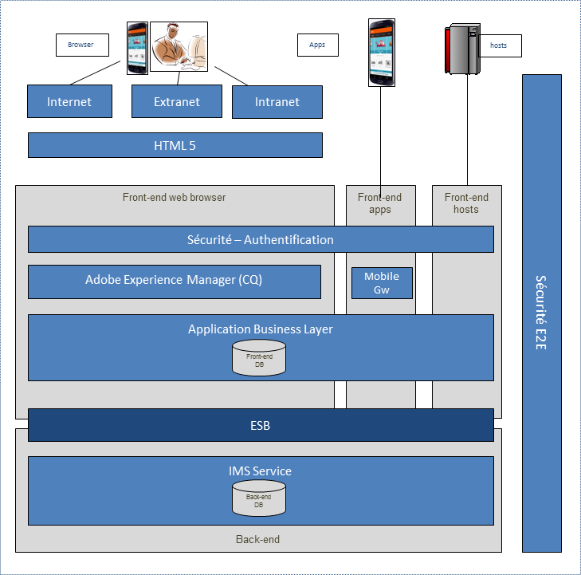
IT challenges and technical solution
CHALLENGE
Build a new transactional web site managed in a modern CMS (Adobe Experience Manager) exchanging data with a legacy main-frame back-end (IMS)
SOLUTION
Use of a SOA Architecture based on Software AG solutions to enable digitalization
Software AG ESB offers capabilities to develop a SOA architecture on the top of legacy IMS. So we are able to populate data and business services to our digitals solutions (Web, mobile, …).

Slide 26
The Future …
Continue the digital journey and manage the replacement of our Core non-life insurance application
Continue to develop and integrate web and mobile services
Evolve to Digital Marketing platform (including social media channels)
Promote digitalization of internal and external processes
Manage the transition from legacy mainframe non-life applications to Guidewire
Promote new products and services on web and mobile using capabilities from Guidewire and integration layer as business differentiator

Slide 27
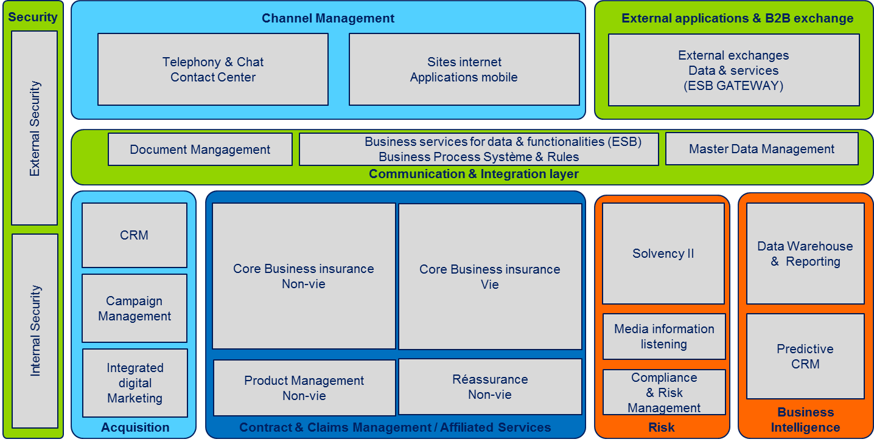
Integration digital layer in the architectural landscape
Software AG integration digital layer give to Ethias (in partnership with NRB) the opportunity to implement and deploy new digital capabilities on Web, mobile and in internal CRM by combining functionalities of legacy and new Platforms.

Slide 28
Thank you for your attention

